Slide 1
Unit 3A
Human Form & Function
Cells, metabolism & regulation
Topic 8: Homeostasis
Regulation of body temperature

Slide 2
Thermoregulation
Maintaining the balance between heat production and heat loss is called thermoregulation.
A temp of 37ºC is the optimum for cellular reactions.
Excess heat produced from cell metabolism must be removed as it can cause nerve malfunction, change in protein structure (enzymes denature) & death.

Slide 3
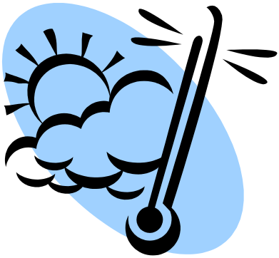
Regulation of body temperature - 1
Physical heat exchange processes

Slide 4
How do we lose and gain heat?
The four methods of heat transfer in and out of the body are:
radiation
convection
conduction
evaporation.

Slide 5
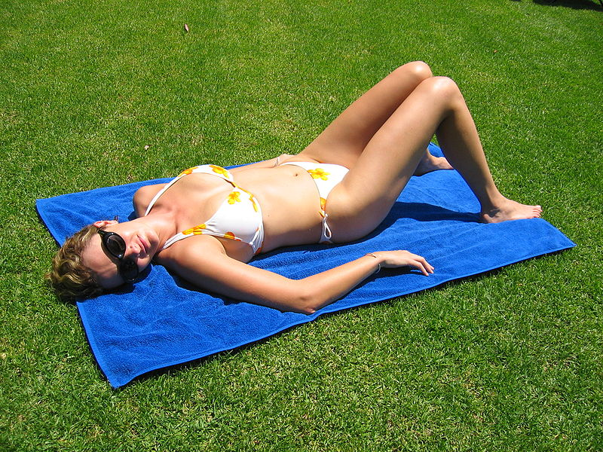
Radiation
There is no direct contact with source
e.g. sun or a fire.
Radiation can result in heat gain or heat loss.

Slide 6
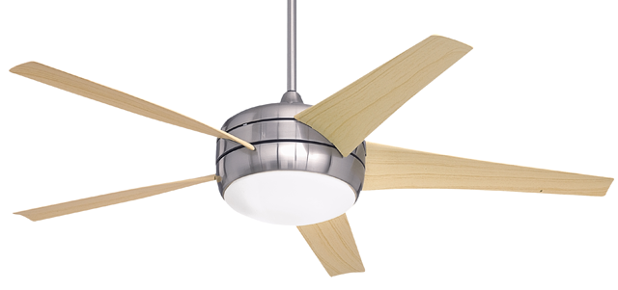
Convection
Involves heat transfer via water or air currents
For example, using a fan or fan heater.
Convection results in heat gain or heat loss.

Slide 7

Conduction
Occurs from direct contact with heat source e.g. standing on hot sand with bare feet.
Results in heat gain or heat loss.

Slide 8
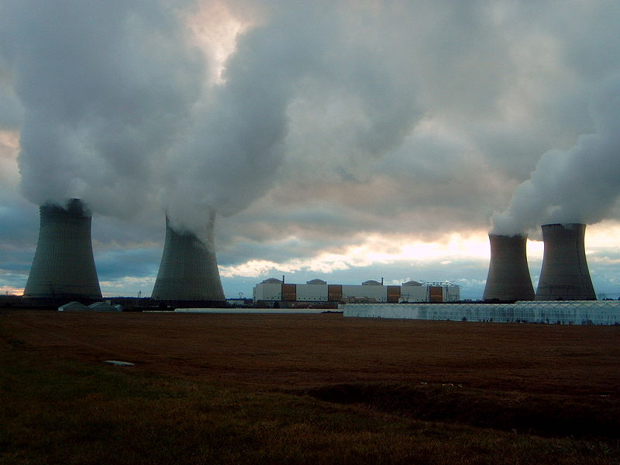
Evaporation
Evaporation is the transformation of water from its liquid state to its gaseous state (i.e. steam or water vapour).
The evaporation of sweat results in heat loss only.

Slide 9
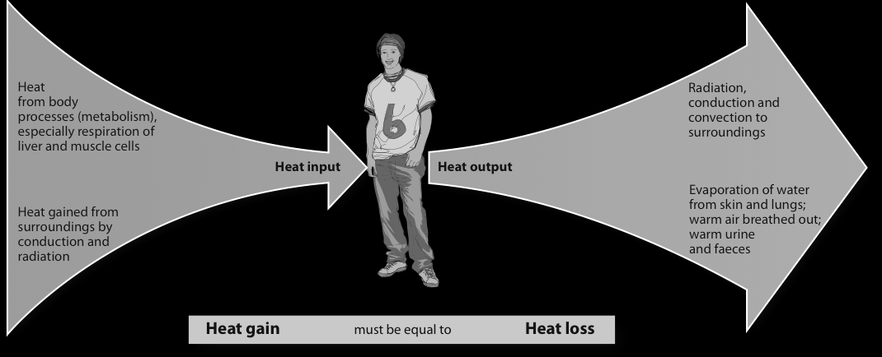
A constant human body temperature is achieved by a balance between heat gain and heat loss.

Slide 10
Thermoreceptors
In skin and mucous membrane = peripheral thermoreceptors.
There are two types of peripheral thermoreceptors
Cold receptor: stimulated by environmental temperatures lower than normal.
Heat receptors: detect temperatures higher than normal.
In hypothalamus = central thermoreceptors.

Slide 11
Thermoreceptors
Central thermoreceptors: Found in hypothalamus, spinal cord & abdominal organs.
Nerve impulses sent out by the hypothalamus control activities that help to either increase or decrease body temperature.

Slide 12
Heat gain versus heat loss
In order to maintain a constant body temperature we must balance heat gain with heat loss.
How do we achieve this?
Humans can respond in two ways:
behavioural - where we consciously change our behaviour
physiological - where our body automatically alters its functioning without conscious control.

Slide 13
Regulation of body temperature - 1
Rapid behavioural response
(stimulus-response)

Slide 14
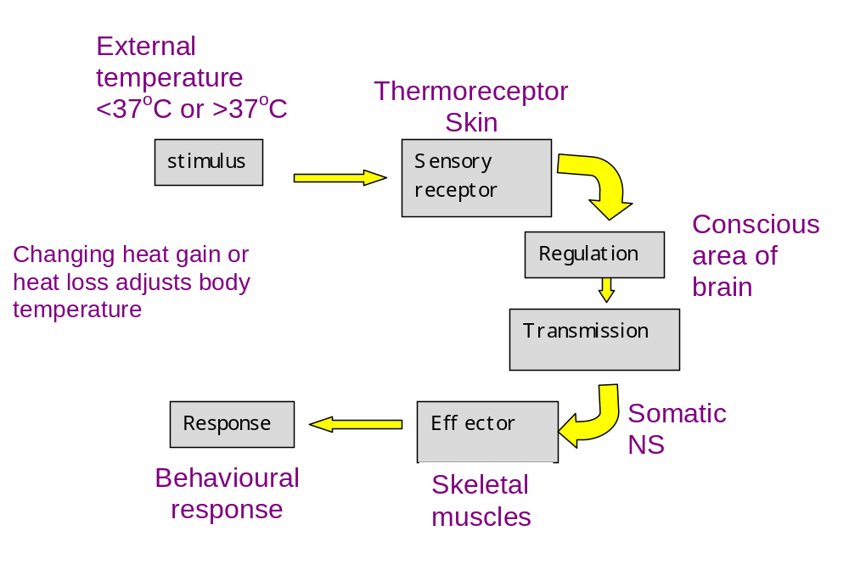
Behavioural responses to change in external temperature

Slide 15
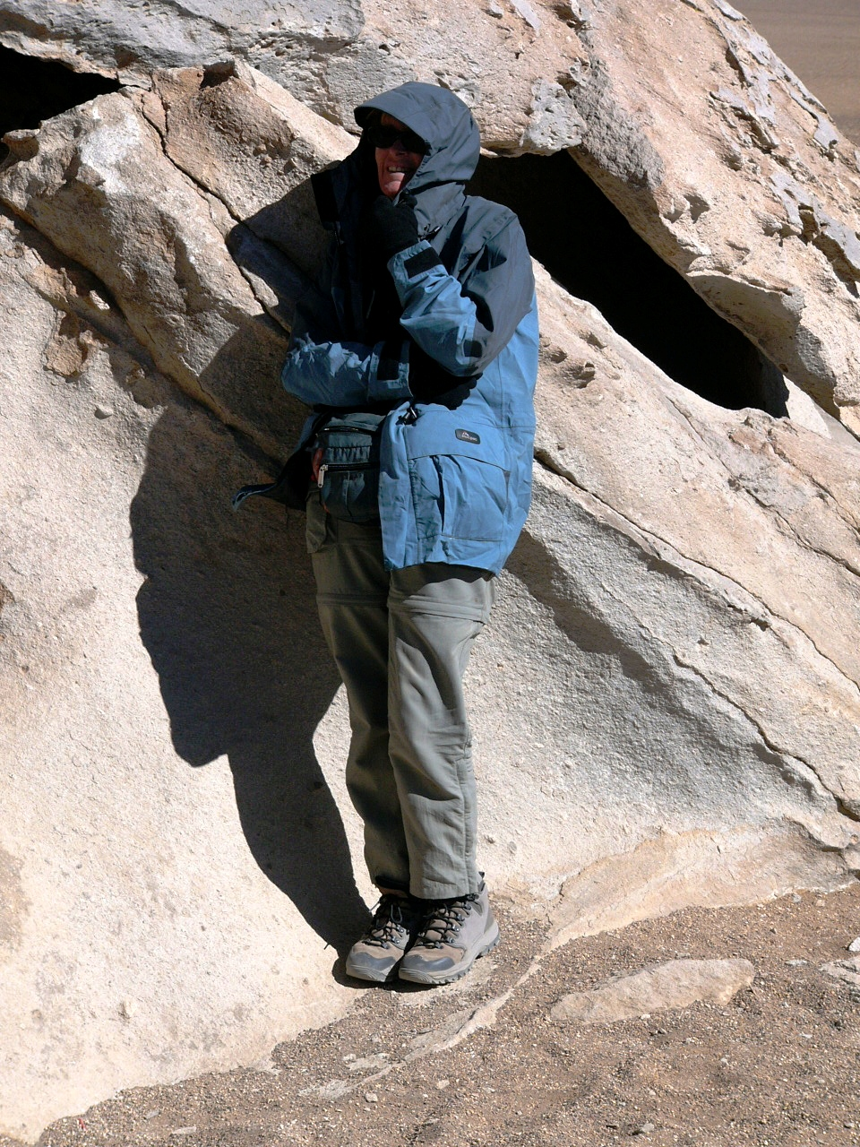
Short-term responses
(stimulus-response)
Stimulus
  External (ambient) temperature
Receptor
  Thermoreceptor (skin)
Control centre
  Brain - conscious area (cerebral cortex)
Transmission
  Nervous system (somatic motor nerves)
Effector
  Skeletal muscles

Slide 16
Regulation of body temperature - 2
Sustained physiological response
(negative feedback)

Slide 17
Conserving body heat
When the body’s core temperature falls below the thermoneutral zone* the body either produces more heat (e.g. shivering), or releases less heat to the environment (e.g. vasoconstriction).
*The thermoneutral zone (TNZ) is the temperature range bounded by the lower critical temperature (the point at which shivering starts) and the upper critical temperature (the point at which sweating starts).

Slide 18
Increasing heat production
Metabolic rate: The rate at which energy is released by the breakdown of food.
Increased metabolic activity during exercise (e.g. more muscular work) or stress (noradrenaline) increases heat production.

Slide 19
Increasing heat production
The shivering reflex involves a fall in body temp which causes the hypothalamus to sent stimuli to parts of the brain that increase skeletal muscle tone. This causes groups of antagonistic muscles surrounding organs being stimulated simultaneously. Producing the shaking sensation we know as shivering, which increases heat production.

Slide 20
Increasing heat production
The hypothalamus causes the Anterior Lobe of the Pituitary Gland to secrete TSH, which causes the thyroid gland to release Thyroxine into the blood.
thyroxine increase the metabolic rate , and thus heat production.
The hypothalamus also stimulates the adrenal medulla via sympathetic nerves to release adrenaline and noradrenaline into the blood. These hormones increase the cellular metabolism, and thus heat production.

Slide 21
Reducing heat loss
The loss of body heat can be reduced by vasoconstriction of the cutaneous blood vessels and (to a limited extent) piloerection.

Slide 22
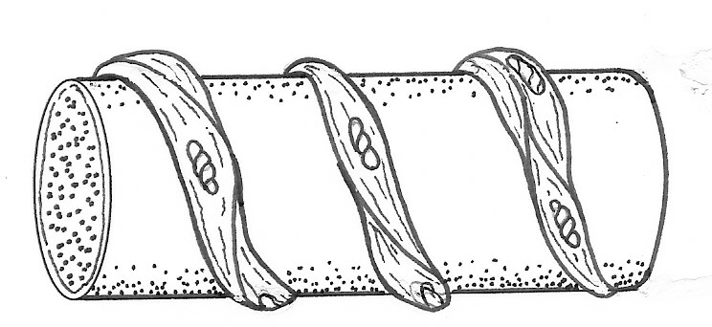
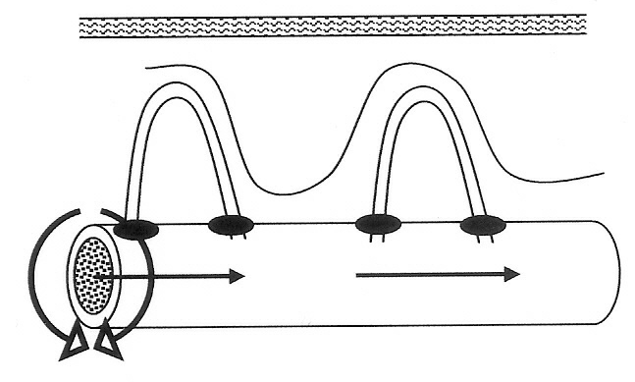
Vasoconstriction
Arteriole
Bands of smooth muscle
Sphincter muscles close
Vasoconstriction
Contraction of the smooth muscle squeezes the arteriole and reduces blood flow to the skin. At the same time, pre-capillary sphincter muscles contract and stop blood flow into the cutaneous capillary beds.

Slide 23
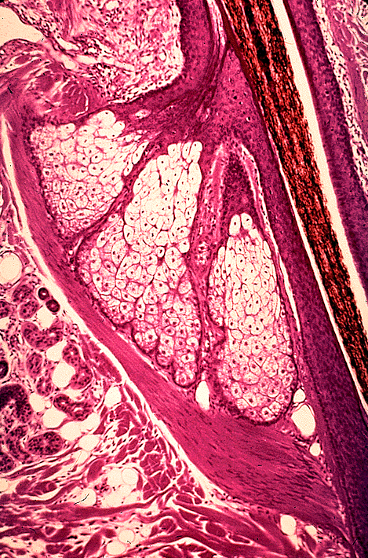
Piloerection
When the arrector pili muscles contract the hair stands on end (piloerection) and gives us goose bumps.
Piloerection increase the thickness of dead air over the skin and reduces heat loss.
Because humans are not very hairy this is not a very effective mechanism.
Hair shaft
Arrector pili muscle
Lutz Slomianka, ANHB - UWA

Slide 24
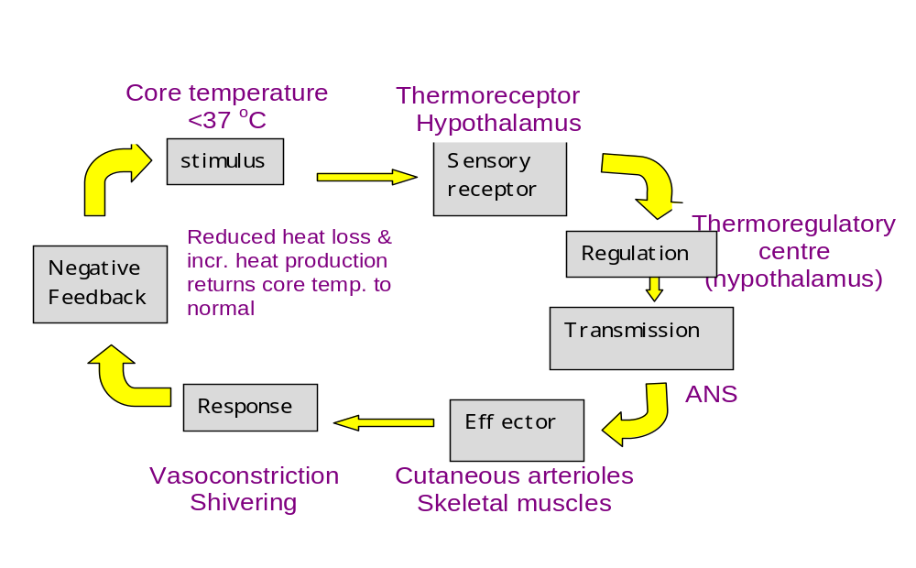
Response to low core temperature

Slide 25
Increasing heat loss
When the body’s core temperature rises above the thermoneutral zone (~38˚C) the body releases more heat to the environment (e.g. sweating and vasodilation).

Slide 26
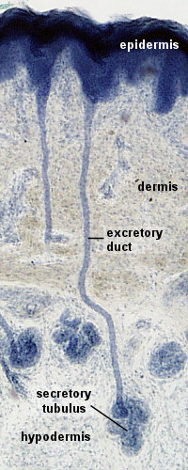
Sweating
Sweat glands secrete sweat, which is carried by the sweat duct onto the surface of the skin. Sweating results in heat loss by evaporation.
Duct
Sweat gland
Lutz Slomianka, ANHB - UWA

Slide 27
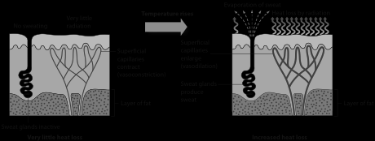
Heat loss from the skin can be increased by vasodilation of skin blood vessels and by sweating.

Slide 28
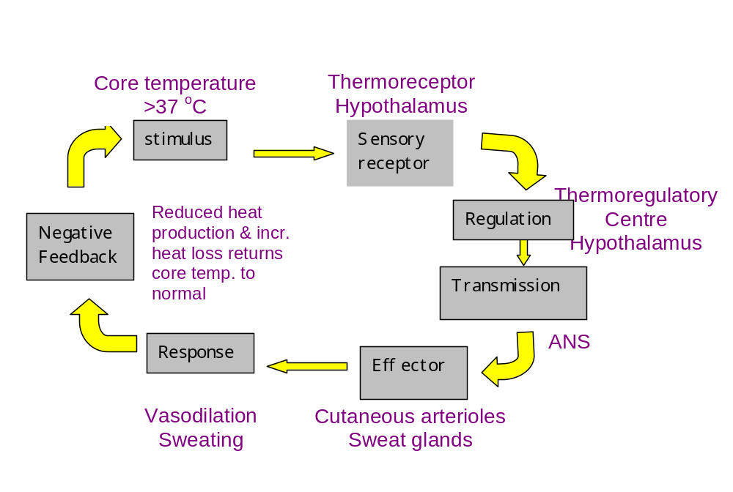
Response to high core temperature

Slide 29
